Slide 1
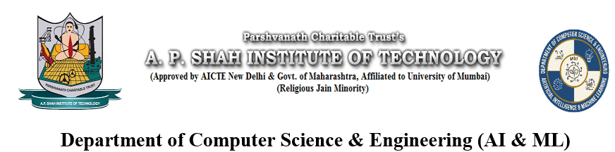
ScanPoint: A Real-Time ID Detection system using ML
Mohit Rajput (22106126)
Harsh Salunkhe (22106133)
Ankit Pawar (22106135)
Jay Wadnere(22106105)
Project Guide
Mst. Shubham Zanwar

Slide 2
Outline
Introduction
Literature Survey of the existing systems
Limitations of the existing systems
Problem statement and Objective
Proposed System
Experimental Setup(Details about input/ dataset, Performance evaluation parameters, Software and hardware setup)
Implementation(Screenshots of all modules)
Conclusion and future work
References
Research Paper Publication / Patent/ Copyright status

Slide 3
Introduction
AI-powered system for automated ID verification
Uses OCR (Tesseract) to extract text: Name, DOB, ID number, Address
Face detection & matching with Haar Cascade + Siamese Network (ResNet50)
Database validation with PostgreSQL for authenticity check
React Native for easy, real-time verification
Applications: KYC, security checks, fraud detection, document authentication

Slide 4
Introduction
The project combines computer vision, OCR, and deep learning to automate ID card verification.
OCR module extracts textual details with error correction for common OCR mistakes.
Face preprocessing & quality checks ensure only reliable facial images are used.
Siamese Network with ResNet50 compares the ID photo with a live/selfie image for biometric verification.
Dynamic thresholding improves accuracy by adapting to image quality.
Ensures multi-layer verification: OCR text check + database validation + face matching.

Slide 5
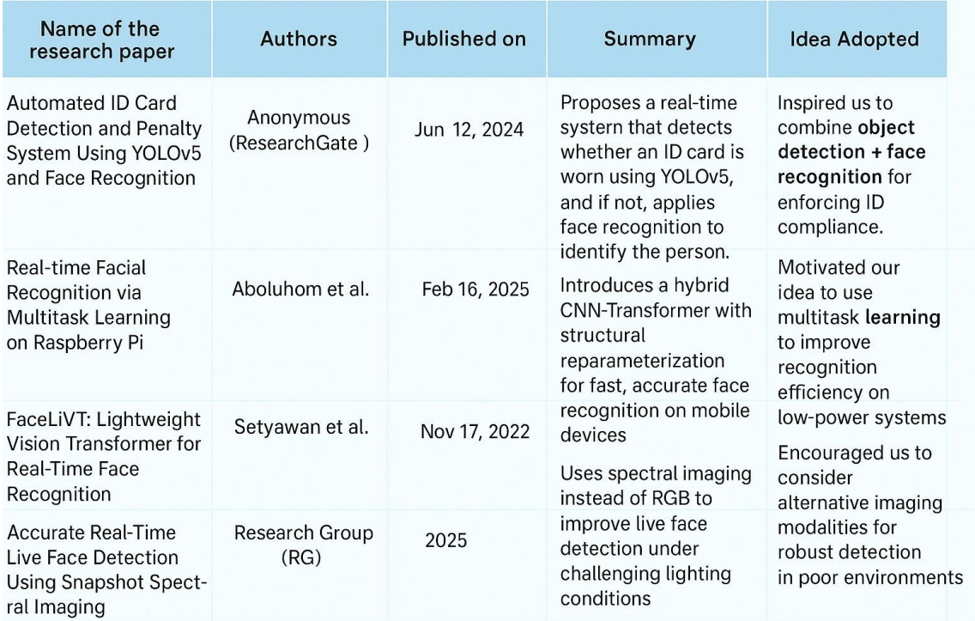
Literature Survey of the existing system

Slide 6
Limitations of Existing Systems
Existing Solutions | Issues / Limitations
Manual ID verification at counters & checkpoints | Slow, inconsistent, prone to human error
Standalone OCR apps (text only, no validation) | Low OCR accuracy on poor-quality images; fragmented
Bank/Insurance KYC apps with limited scope | Limited to specific sectors; not customizable
Third-party ID verification services (Onfido, Jumio) | High cost, privacy concerns, mostly cloud-based
Government Digital Identity Platforms (Aadhaar, DigiLocker) | Dependence on central infrastructure; no face matching

Slide 7
Problem statement
"To design and implement an AI-powered ID verification system that integrates Optical Character Recognition (OCR) and deep learning-based face matching to accurately extract and validate user identity from ID cards, while addressing challenges of image quality, fraud detection, and real-time processing efficiency."

Slide 8
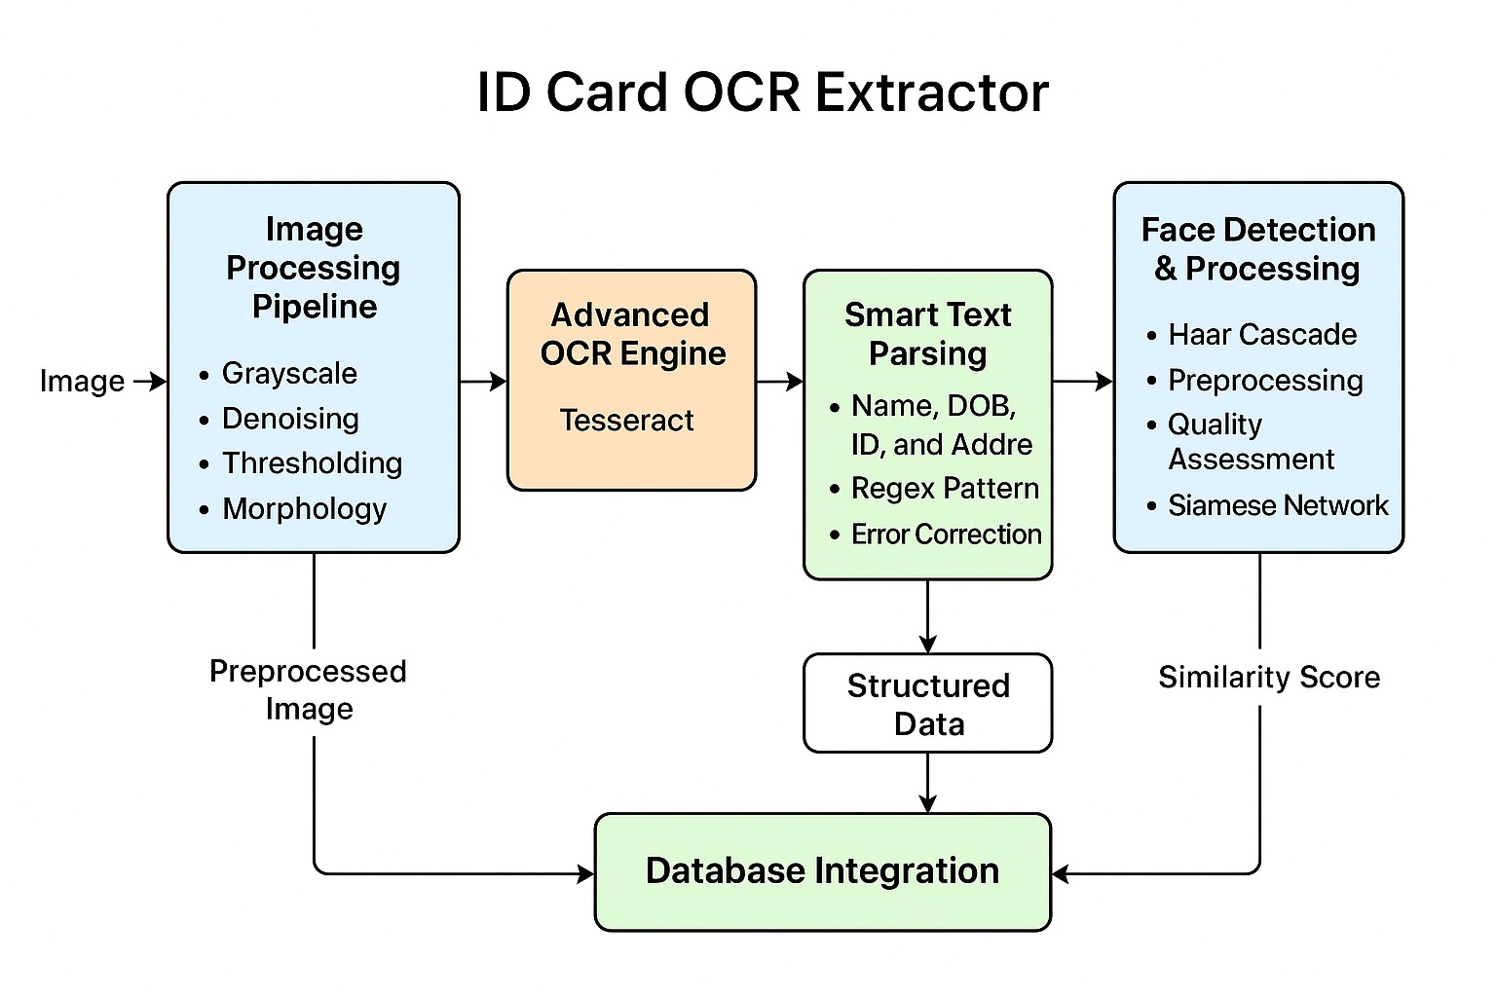
System Design

Slide 9
Technologies and methodologies
OpenCV Preprocessing
  Grayscale, denoising, Otsu & adaptive thresholding, morphological ops.
  Our customization: Multi-variant pipeline to handle poor quality IDs, auto-selects best result.
Tesseract OCR
  OCR engine with configurable PSM/OEM modes; regex-based parsing.
  Our customization: Automatic error correction (O→0, I→1), Indian state code mapping, auto uppercasing.
Regex Parsing
  Extracts DOB, vehicle/ID numbers, multi-line addresses.
  Our customization: Support for multiple Indian formats + heuristics for name detection.
.

Slide 10
Technologies and methodologies
Database Validation (PostgreSQL / Supabase)
  Verifies extracted IDs against a preloaded database.
  Our customization: Hardcoded Indian DL codes; returns legit/fake/unknown; fails gracefully on connection errors.
Face Detection & Matching
  Haar Cascade + Siamese Network (ResNet backbone, L2 normalization).
  Our customization: Adaptive thresholds based on quality; multi-scale testing; quality scoring & rejection for low-quality faces.
React Native
  Real-time processing, side-by-side previews,
  Our customization: Minimalist, professional interface with live debugging of preprocessing.

Slide 11
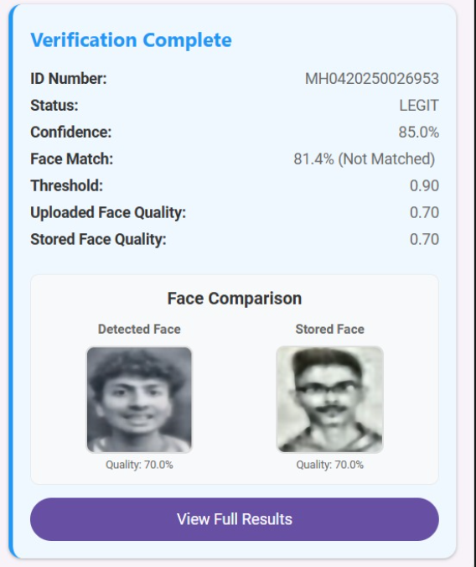
Implementation

Slide 12
References
[1]S. Kilany, R. Al-Hadad, F. Al-Hadad and H. Ahmed, “A Comprehensive Survey of Deep Face Verification Systems,” Scientific Reports (Nature), vol. 15, art. 15753, Jan. 2025. [Online]. Available: https://www.nature.com/articles/s41598-025-15753-8
[2]M. Arif, R. Kumar, A. Sheikh and N. Kumar, “Siamese Networks for Multiple Face-Detection and Identification,” Proceedings of the International Conference on Next Generation Information System Engineering (NGISE), Mar. 2025. [Online]. Available: https://www.researchgate.net/publication/394585881_Siamese_Networks_for_Multiple_Face-Detection_and_Identification
[3]D. Bhattacharya, A. Gajool, S. Banage, S. Bhute and D. V. Gore, “Face Verification using Twin Convolutional Neural Networks,” Conference Paper, PES Modern College of Engineering, Jun. 2025. [Online]. Available: https://www.researchgate.net/publication/392405618_Face_Verification_using_Twin_Convolutional_Neural_Networks
[4]A.J. Jayachandran, “Investigating Fairness in Facial Verification with Siamese Neural Networks,” ACM Proceedings, Oct. 2024. [Online]. Available: https://dl.acm.org/doi/10.1145/3701268.3701276
[5]S. Carta, “An End-to-End OCR-Free Solution For Identity Document Recognition (IDR),” Procedia Computer Science (Elsevier), vol. 232, pp.--, 2024. [Online]. Available: https://www.sciencedirect.com/science/article/pii/S1877050924024657

Slide 13
Thank You...!!

